Slide 1
Lecture 21 - Role of Test and Measurement In Good Systems Engineering

Slide 2
A perspective
Modern systems engineering instruction puts a lot of focus on process
  Requirements functional decomposition, interface control, systems modeling, hazard/risk management etc…
From my perspective, modern systems engineering instruction does not put enough emphasis on test and a measurement
  A requirement without a test is just marketing
  A test without a measurement is just a demonstration of a design operating at a point
Good systems engineering cannot exist without test and measurement
  Cooking analogy – would you want to eat a cake prepared by bakers who only prepare and bake the cakes but never taste them ?

Slide 3
Isn’t instrumentation a subsystem ?
True enough, instrumentation is often a subsystem in a vehicle or element of a vehicle
But instrumentation for systems test and measurement is a larger issue
  Instrumentation to measure integrated performance of a vehicle (e.g. shuttle launch loads) may not be within the purview of a single element
    May require coordinated observation of sensors on many elements of the vehicle, perhaps even across multiple data systems
  Instrumentation may be required to measure the design environment, not the performance of the subsystem
    Measuring overpressure due to SSME and SRB ignition at the pad
  Instrumentation of interfaces is often ignored
    Current and voltage at shuttle-payload interfaces must be inferred – no direct measurement
  Required instrumentation may not be on the vehicle
    Video coverage, tracking radars may be ground or airborne based

Slide 4
Test and Measurement as an integral part of the successful design process
Test and measurement has always been an integral part of the successful design process
In Secrets of Apollo by Johnson – the need for adequate instrumentation is mentioned in
  Chapter 1 – need for telemetry
  Chapter 4 – lessons learned particularly in early Corporal program
In Inviting Disaster by Chiles – improperly designed instrumentation (which did not show it was out of range high) misled operators and led to BOTH Apollo 13 and the Three Mile Island powerplant accident
In Engineering the F-4 by Bugos – design of instrumentation laboratories, telemetry laboratories and the knowledge of how to instrument models and flight vehicles were identified as key parts of the systems engineering process
Several historical and more recent examples can demonstrate this

Slide 5
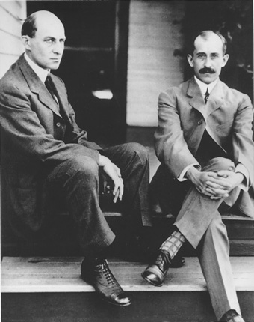
So much more than bicycle mechanics
Their methodical science based approach making extensive use of test and measurement allowed them to do what had eluded man for thousands of years
They started in 1900
They succeeded in 1903
Wilbur (left) and Orville Wright (right)

Slide 6
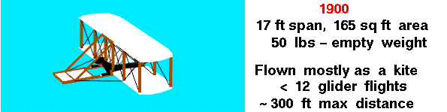
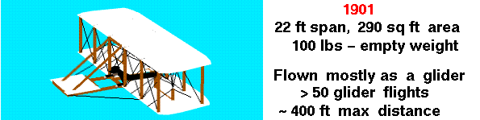
Wright Brothers
Overview of Wright Brothers Discoveries
http://wright.nasa.gov/discoveries.htm
Notes:
The Wright Brothers understood how hazardous flight was. They understood that one fatal accident would end their effort. So they started flying their design as a kite. This gave them the capability to test at low risk. They also understood that control was a key requirement. This distinguished them from other people attempting to solve the problem. Others thought the control problem could be solved by simply shifting weight. The Wright Brothers understood that they had to balance all of the forces and moments. When they were confident that their kite was balancing the forces, they flew it first as a glider. When they couldn’t learn anymore from that glider, they went back and built a new glider incorporating their lessons learned. By the time they were finished in 1901 they were accomplishing impressive flights and their problems seemed behind them. But big surprises were on the way. When they compared the performance of the glider to their computations they discovered that its performance was so much lower than their computations that it would not be capable of powered flight. It so exasperated them that one of the brothers remarked “Man will not fly for a thousand years”. But by solid engineering they would do just that in two years time.

Slide 7
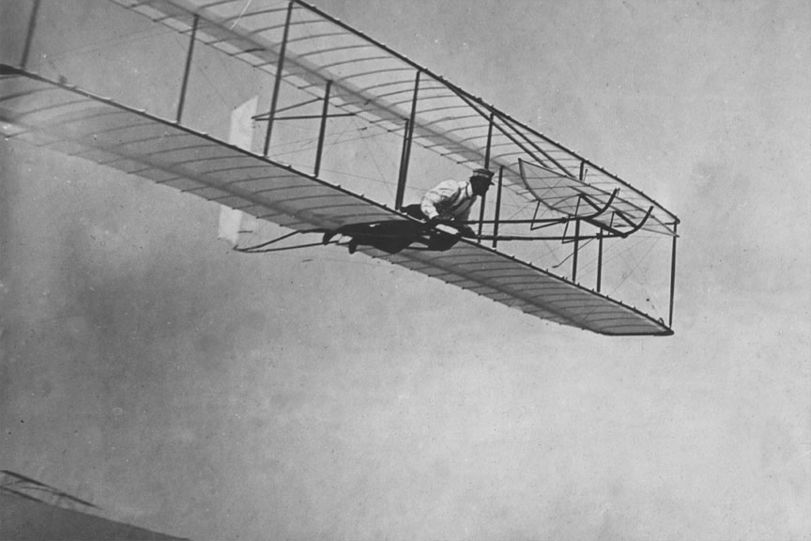
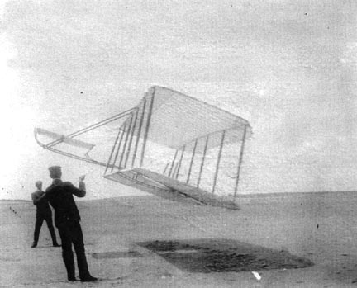
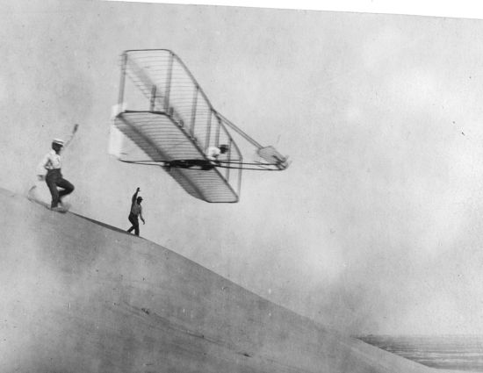
1900-1901 Glider
Tests at Kitty Hawk NC

Slide 8
Wright Brothers Flight Test Instrumentation
Anemometer – wind speed
Inclinometer – angle of glide, when flying a glider as a kite they could compute lift and drag from the angle of the lines
Tape measure – length of flight
Stop Watch – length of flight
Spring Scales – force when flying gliders as kites

Slide 9
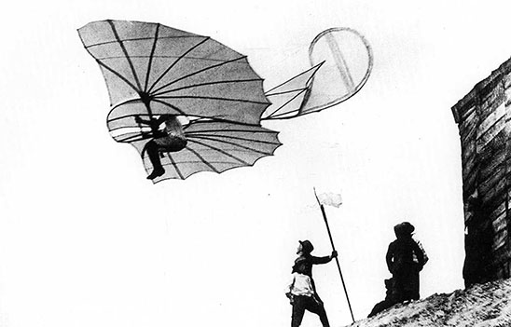
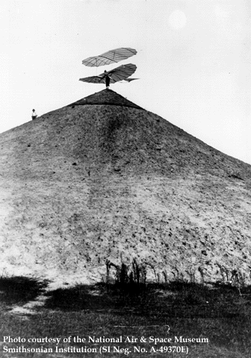
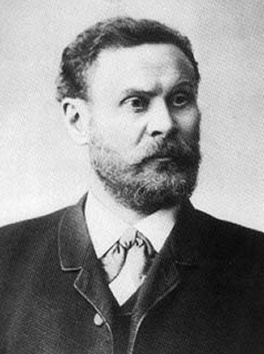
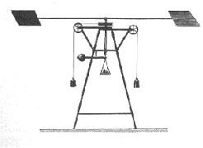
To design a flying machine is nothing,
To build one is not much,
To fly it is everything
Otto Lillienthal
1848-1896
Lillienthal used a rotating arm to compute lift and applied the results to design of gliders. Wright Brothers used tables of lift computed by Lililienthal in the design of their 1900 and 1901 gliders
Notes:
Otto Lillienthal was a German aviation pioneer. He built and flew his own gliders and even built his own hill in Germany for testing the gliders. He had a deep desire to understand why the gliders worked and even built his own rotating wind tunnel to develop quantitative relationships . His statement about flying machines is just as true today as it was in 1896. He died after a crash of one of his gliders that he was flying. His last words echo today “Sacrifices must be made”.

Slide 10
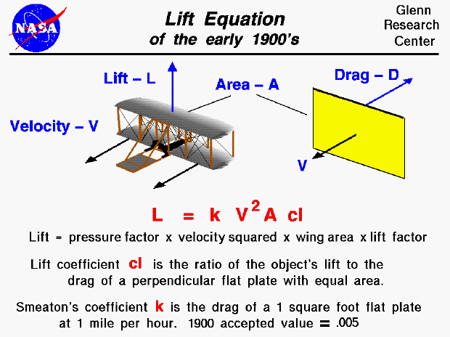
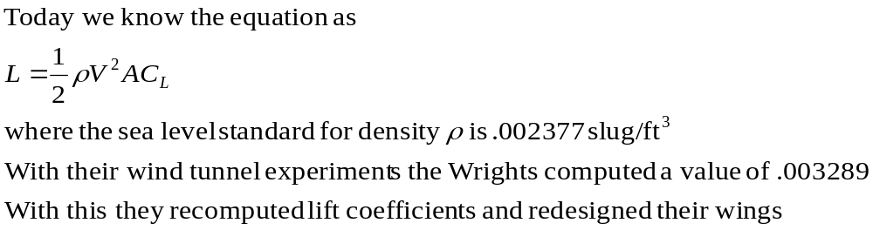
Notes:
This chart explains why the Wright Bothers glider underperformed. At the time there was a basic misunderstanding of the lift equation. Scientific thinking of the time believed that lift was proportional to a constant times the velocity squared times the surface area times the lift coefficient (a measure of the wings efficiency). That constant was estimated at .005. This meant that everyone was over-estimating the amount of lift that they would get out of a given configuration. But the Wright Brothers didn’t know that yet. They had to discover this for themselves.

Slide 11
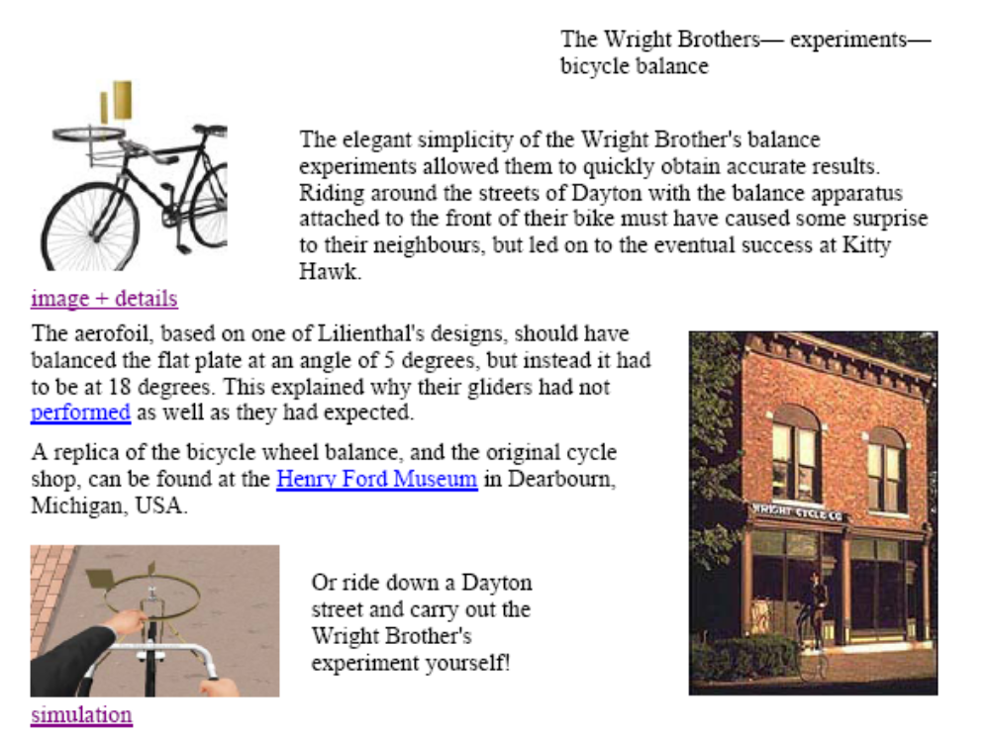
The Wright Brothers Bicycle Experiment
Notes:
The Wright Brothers devised an elegant experiment to try to understand what was going wrong. They designed two airfoils whose difference in performance should have been a certain amount. They mounted the two airfoils on a bicycle wheel on the handlebars of a bicycle. With the two airfoils generating different forces the wheel should have rotated by a certain amount to allow the forces to balance out. Instead, they balanced out at a much larger angle. This showed that the estimates for lift were drastically wrong. The test didn’t say by how much or why, but in this simple test with simple measurements they proved what was the problem. But then they had to figure out the nature of the problem.

Slide 12
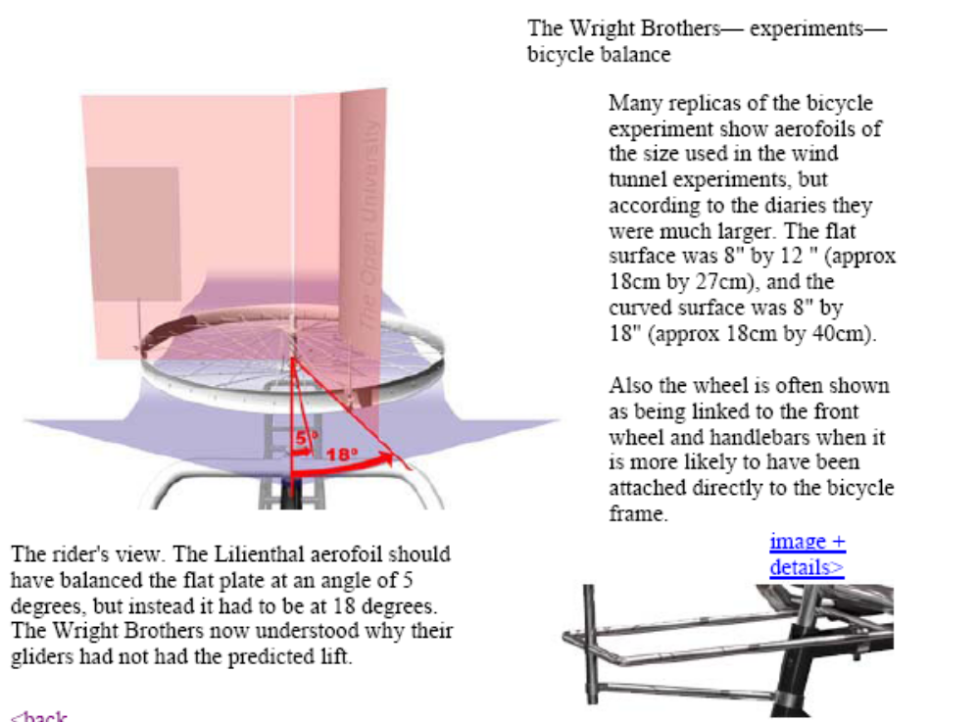
Wright Brothers – the bicycle experiment
http://firstflight.open.ac.uk/experiments02.html

Slide 13
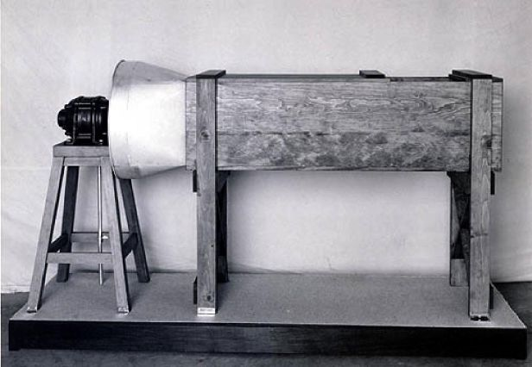
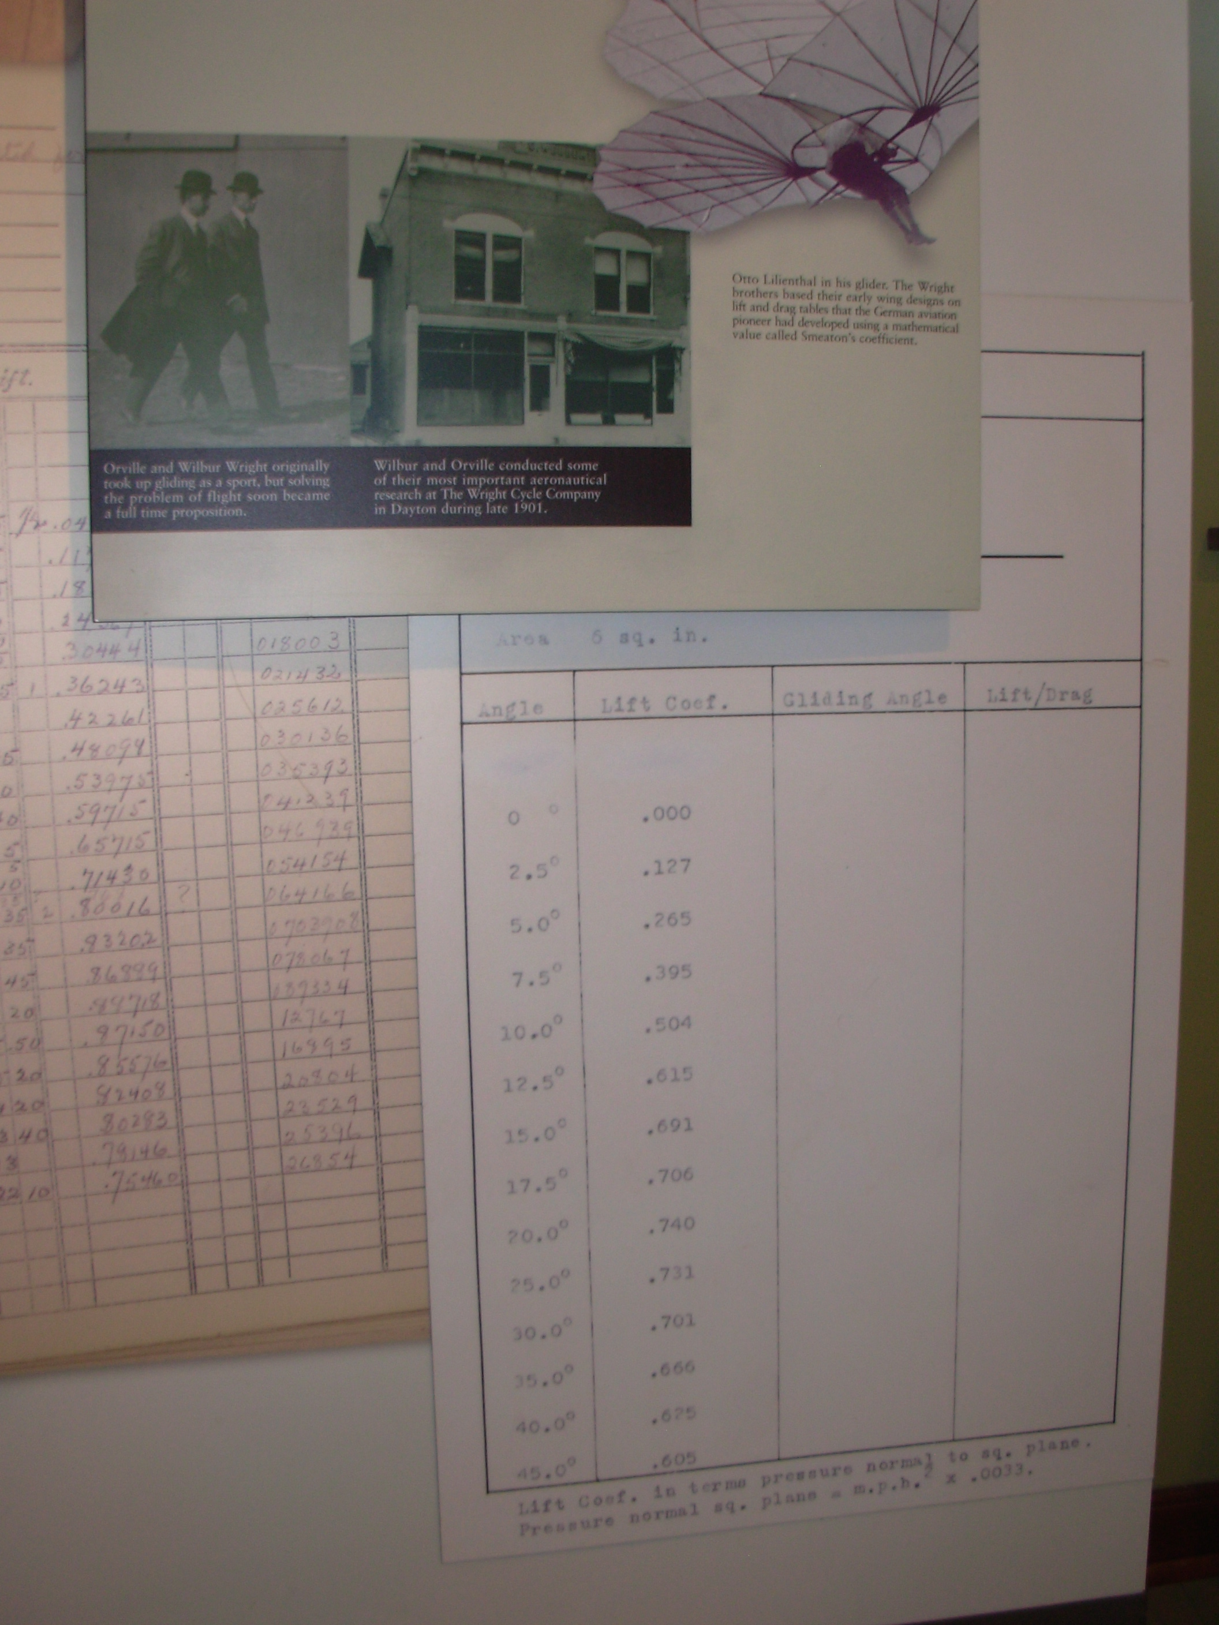
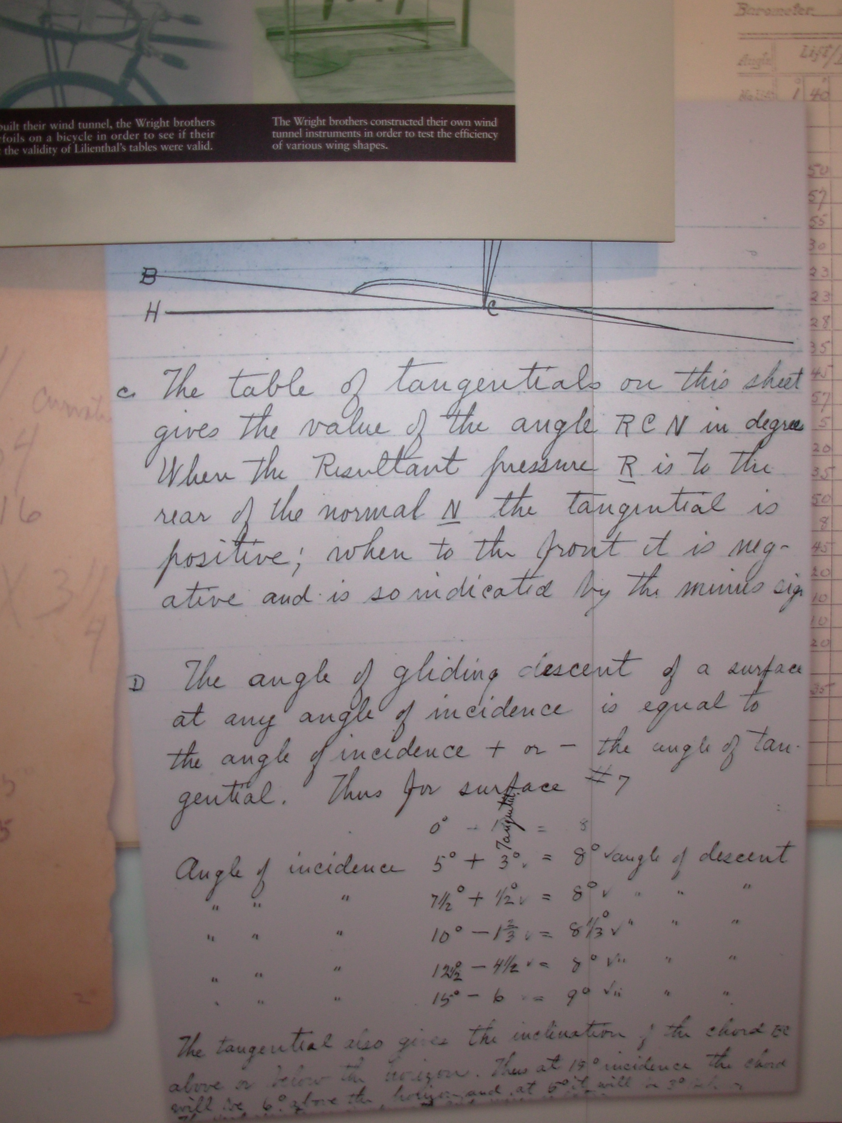
When performance of the 1901 glider did not meet predictions, the Wright Brothers built their own wind tunnel and found error in Lillienthals data
Notes:
In order to understand the exact nature of the problem, the Wright Brothers needed to conduct additional testing with the ability to control conditions and make precise measurements. To do this, they constructed one of the world’s first wind tunnels.

Slide 14
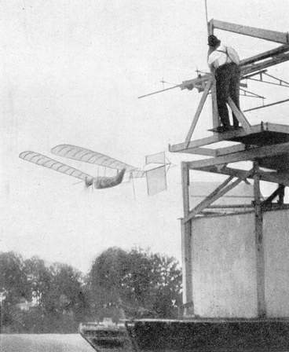
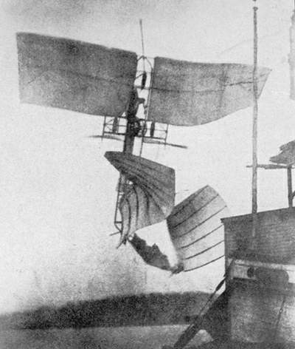
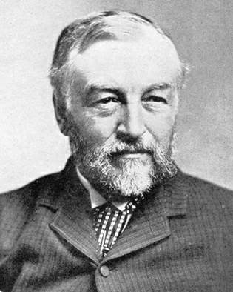
Full Scale
Subscale
Samuel Langley, curator of the Smithsonian, convinced his subscale model
success was sufficient understanding of the problems of flight,
pressed directly to full scale with horrible results just days before the
Wright Brothers succeeded
Notes:
It is interesting to note that at the same time that the Wright Brothers were working through the differences between their calculations and their subscale glider performance, Samuel Langley, curator of the Smithsonian and a distinguished scientist in his own right, had built a subscale model of a flying machine and had convinced the US Government to fund a full scale machine. Langley had not compared his subscale results to predictions and he turned down the opportunity to test in a wind tunnel. Just weeks before the Wright Brothers succeeded, Langley failed with his full scale vehicle. All because he failed to recognize the demonstration of a subscale model and the real value of test and measurement to understand what is really going on.

Slide 15
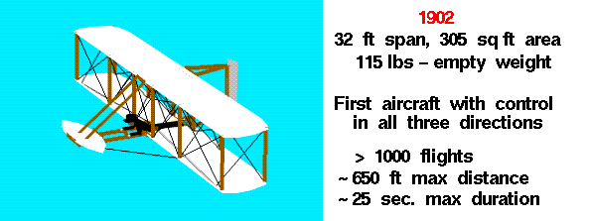
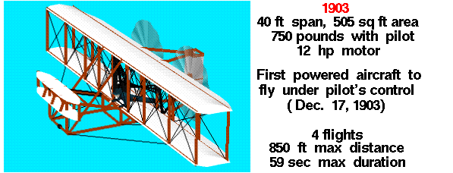
Notes:
The 1902 glider confirms the Wright Brothers wind tunnel results. Based on the full scale testing as a glider. They go forward with the powered 1903 version which becomes the worlds first successful heavier than air flight vehicle.

Slide 16
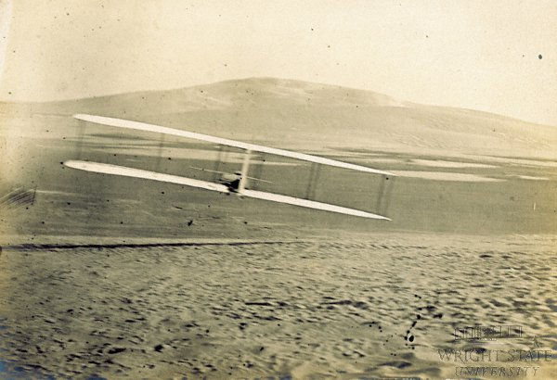
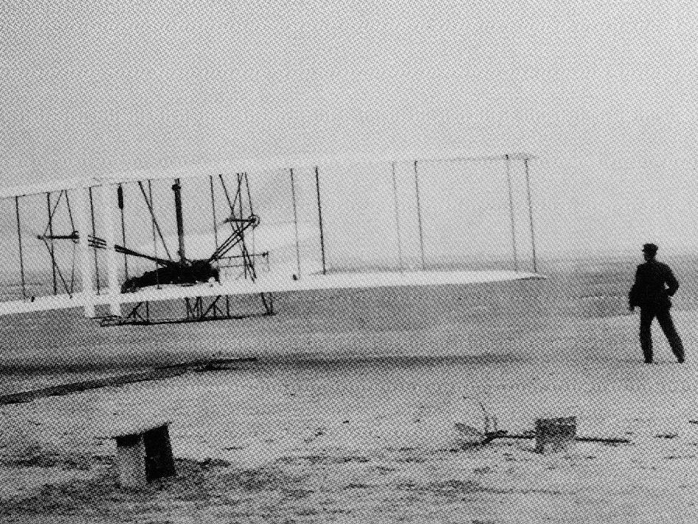
1902 Glider – first coordinated turn
1903 – first successful heavier than air flight

Slide 17
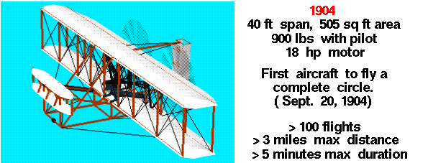
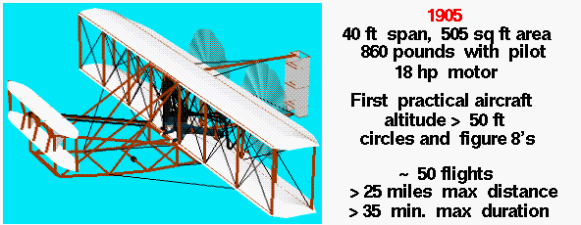

Slide 18
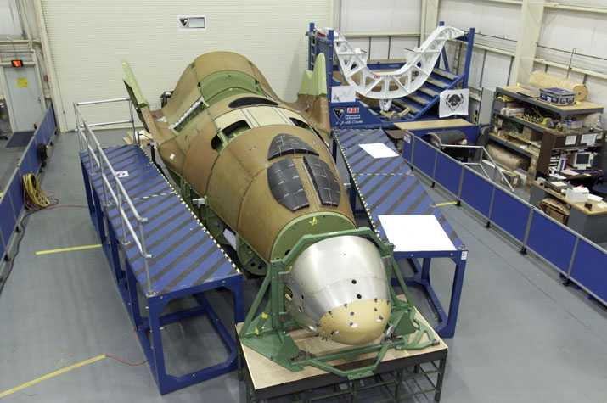
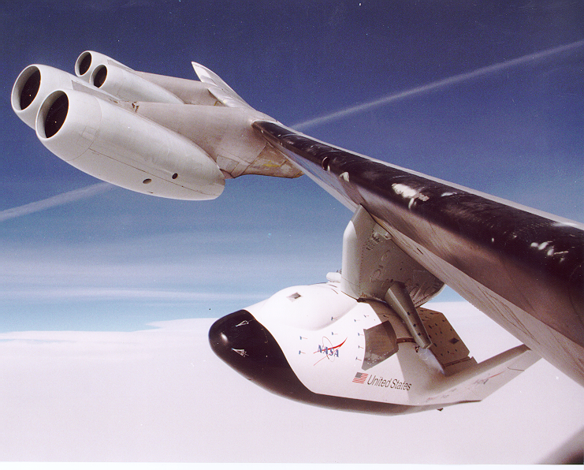
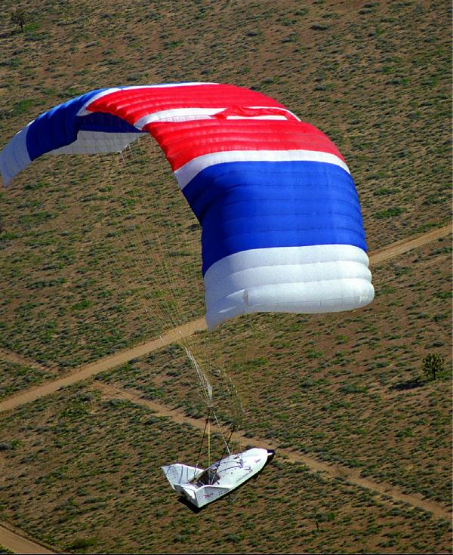
X-38 Crew Return Vehicle- Fast Forward 100 years
Designed as an ambulance/lifeboat for the International Space Station
X-38 is a spacecraft with propulsion system on-orbit, uses its lifting body shape for entry and then deploys a large parafoil at 15,000 feet for final descent and landing
Prototypes built and test flown 8 times at Edwards Air Force Base
  Large parafoil flown over 40 times at Yuma Proving Ground
Program cancelled with a space test vehicle fully assembled for shuttle flight
Notes:
The X-38 was a very successful experimental vehicle that was scheduled to become the ambulance and lifeboat for the space station. Cancelled by the Bush administration because of cost overruns in the larger space station program, the X-38 space vehicle was over 85% complete and approximately 18 months from a space test. For more information about the X-38 see http://www.astronautix.com/craft/x38.htm, or http://en.wikipedia.org/wiki/NASA_X-38.

Slide 19
X-38 Parafoil development
The X-38 parafoil at 7500 sq ft of wing area was easily twice the size of any previously successful parafoil
  A Boeing 747 only has 5500 sq feet of wing area
10 Previous teams had attempted to deploy large parafoils (> 3500 sq ft) without success
During initial testing (first 10 tests) the deployment dynamics were outside of the experience of the parachute community
Testing was expensive ($250k/test) and we could only test every 4-6 weeks – prohibited a conventional cut and try methodology normally used by the parachute community
Dynamics were outside of the ability of the analytical community to handle
  Flexible structure. Inflation was random and the progression of inflation affected the balance of forces and moments during inflation and the subsequent dynamics
So we used a physical model – 1/10th scale parafoil (750 sq ft)
  Started with truck tow testing – my first LabVIEW VI was monitoring strain gages on risers
  Could test 4-5 in a day dropping from a helicopter for $5k/day
  Instrumented – measured strains in rigging and could compute moments and derive forces
  Lower altitude also allowed for better photographic coverage
After 250 subscale tests we had enough data to establish proper rigging to minimize dynamics and to start to build analytical models
  Resumed full scale testing with immediate improvement

Slide 20
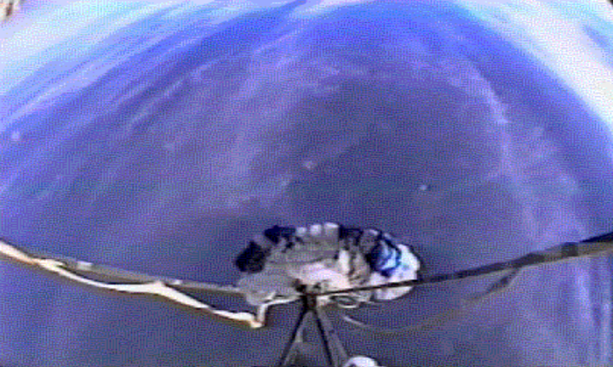
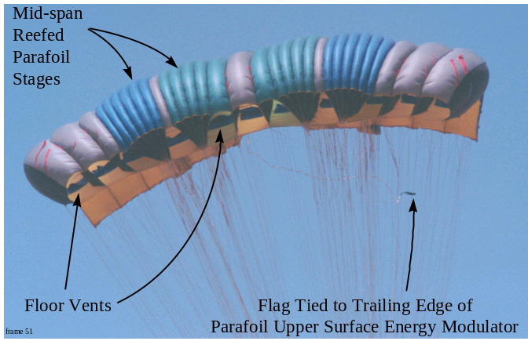
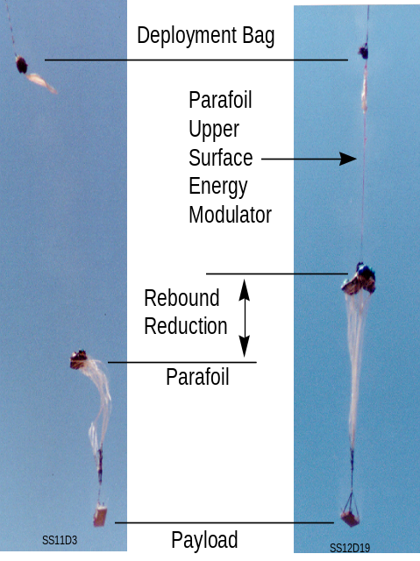
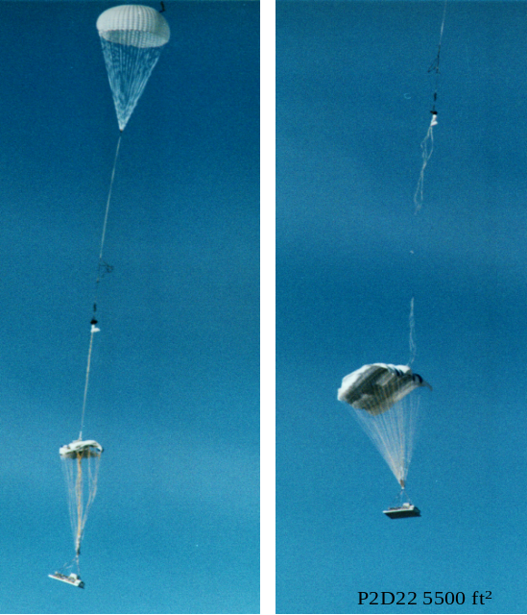
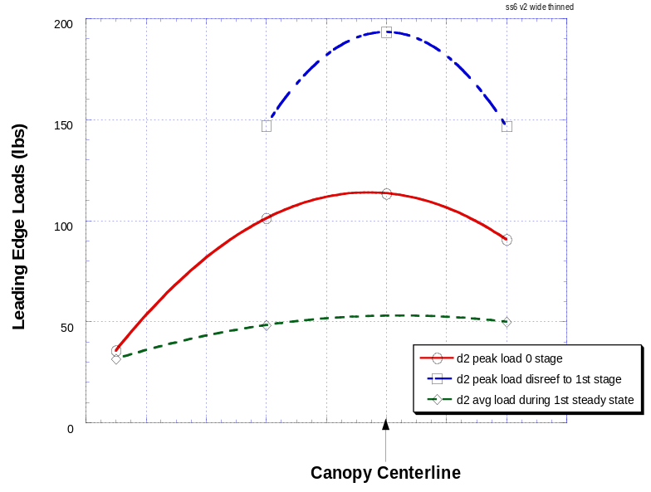
Subscale Versus Full Scale
Notes:
The left side of this chart shows the subscale testing (750 sq ft wing area) and the right side shows the full scale test (7500 sq ft). Their performance was almost identical.

Slide 21
Integrated Test and Measurement in the Shuttle Program
The shuttle integration organization was heavily into test and measurement from its start through the 1980’s
Starting in the 1990s the focus shifted more to requirements and interface management and the use of computational tools to predict design environments and integrated performance
  Truly pioneering work performed in the application of computational fluid dynamics
Despite multiple changes to outer moldlines of SRB, ET and orbiter no wind tunnel test were run after the 1980’s and limited flight measurements were made to assess integrated performance
After the Columbia accident, we were challenged to redefine design environments for new designs and to understand the thermal, pressure, acoustic and vibrational causes of debris as well as predict the paths of debris in the shuttle aerodynamic flowfield
This required the revamped Shuttle Systems Engineering and Integration organization to undertake a massive test and measurement campaign to
  Re-establish the design databases
  Provide the design environments for design changes
  Understand the aerodynamics and trajectories of debris

Slide 22
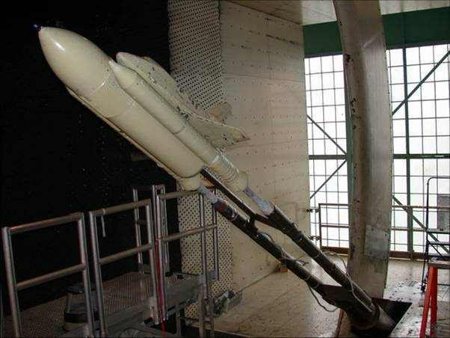
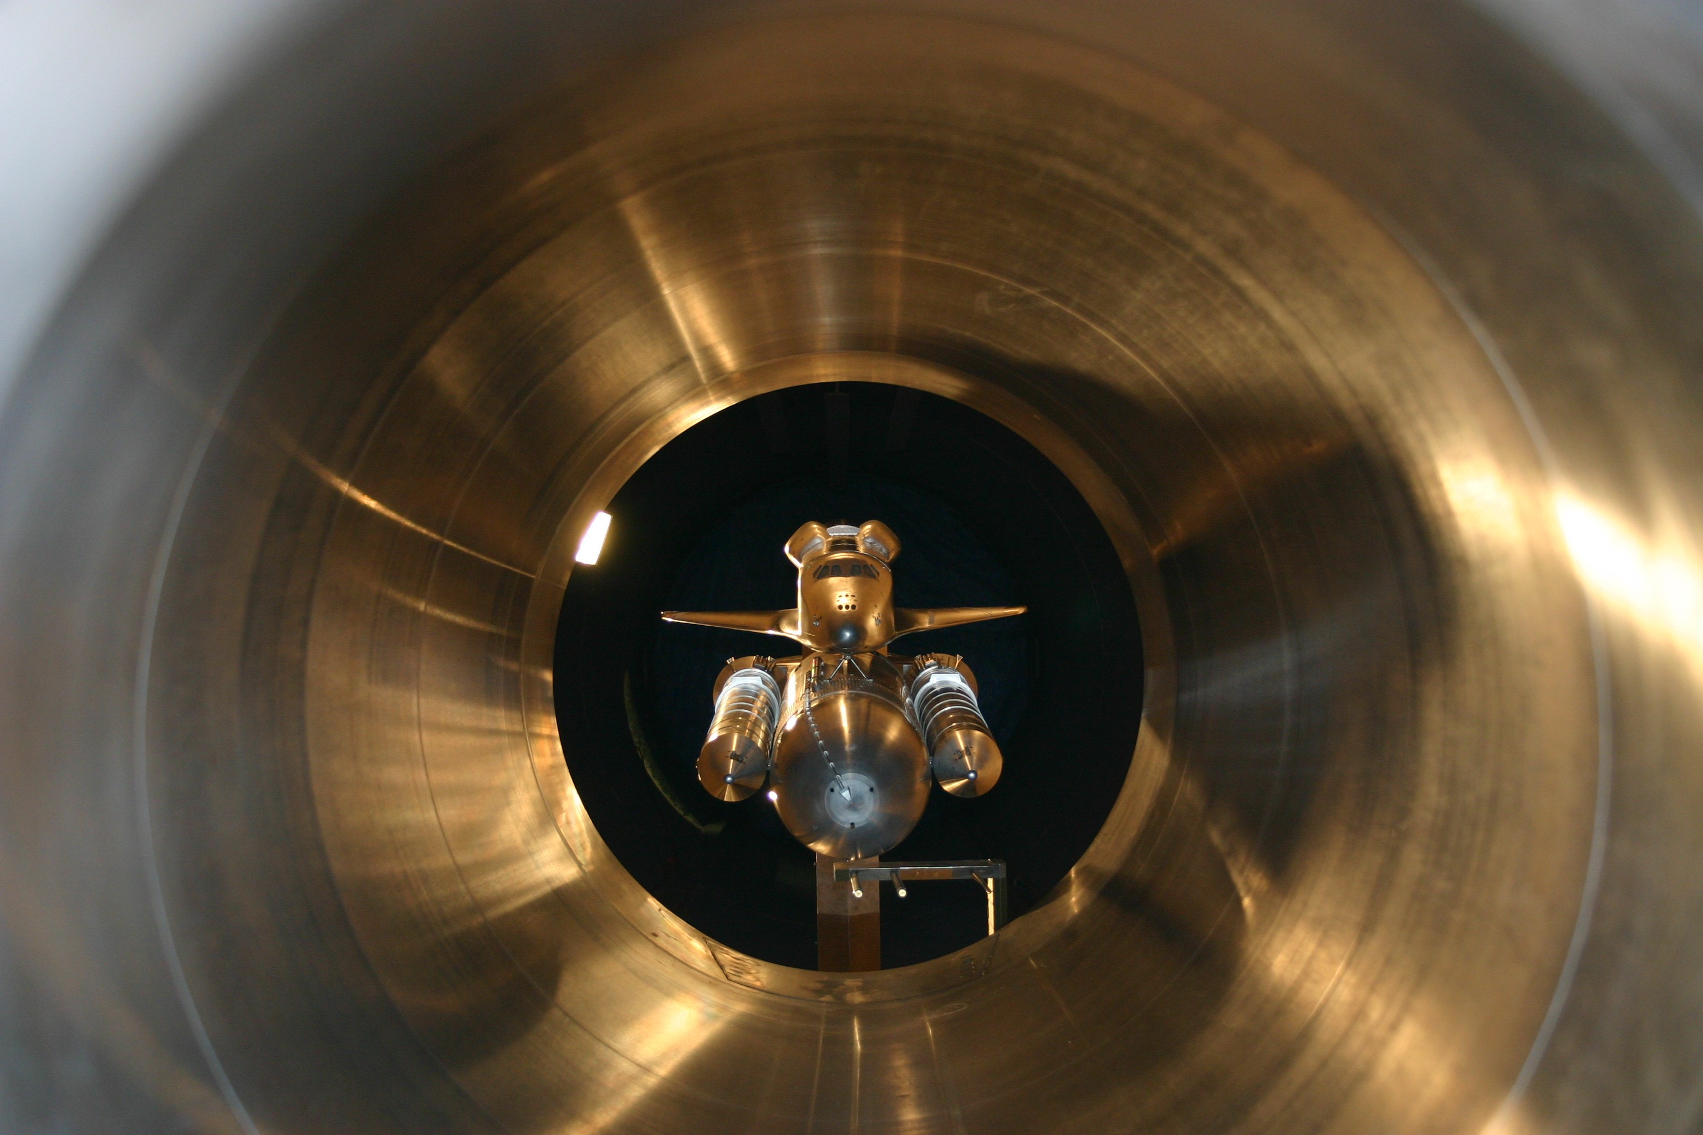
Wind tunnel tests at Ames and Arnold Engineering Development Center generate Pressure Distribution, Forces, Moments and Flow field for transonic and low supersonic speeds
Use Particle Imaging Velocimetry to estimate flow velocities critical for transport
Use 3 % and 3.5% wind tunnel models updated to the current vehicle configuration to generate validation data for the CFD
Use CUBRC shock tunnel to generate thermal environment critical for debris generation models

Slide 23
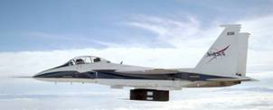
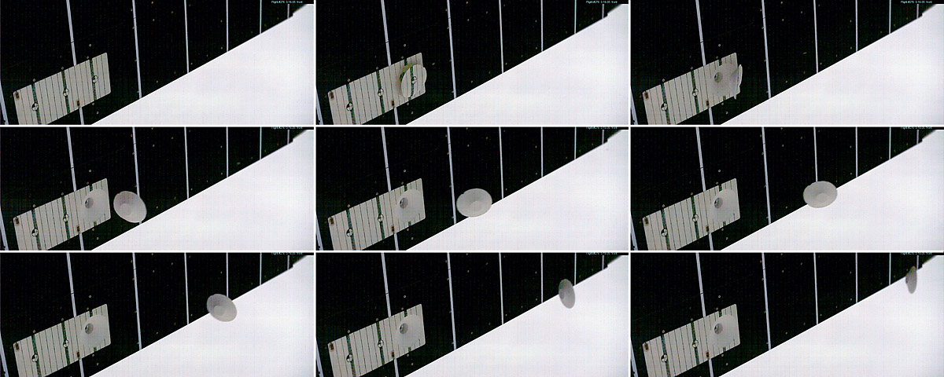
F15 Debris Liberation tests to confirm divot flight dynamics
Notes:
This chart shows the efforts at the Dryden Flight Research center to gather test data on the aerodynamics of foam debris. Foam debris was generated from a test fixture suspended beneath a F-15 flying along the shuttle launch trajectory at speeds up to Mach 2 and at altitudes up to 50,000 feet. The big question was whether the divots would trim up and fly farther down the vehicle or whether they would tumble and not fly very far. As the extremely high speed imagery shows, the foam divots trim up and fly just fine. To get this imagery, Dr Stephen Corda and the team at DFRC had to use some of the highest speed video equipment ever used in flight test.

Slide 24
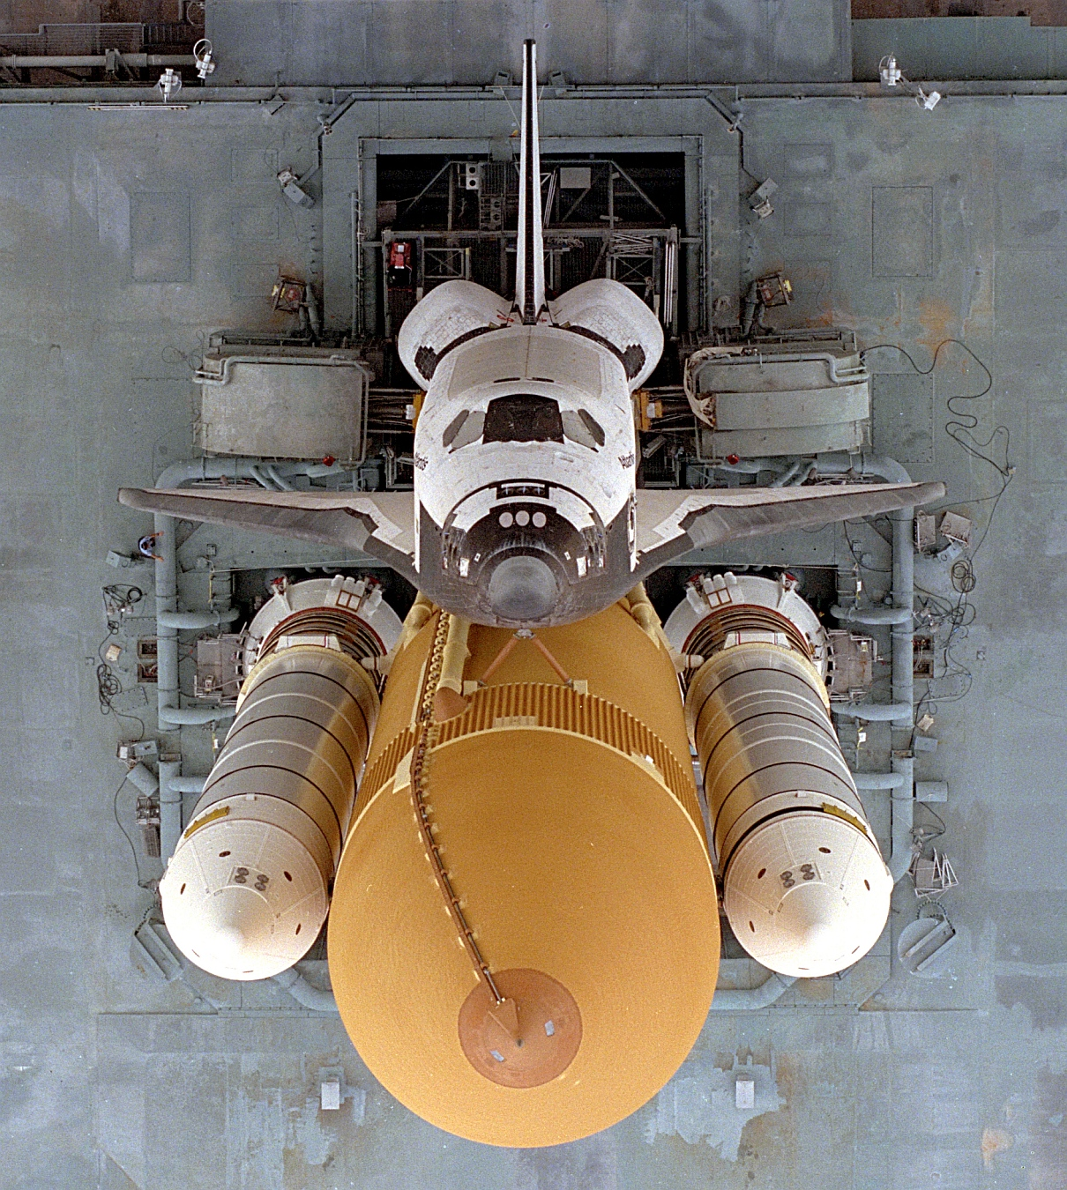
Test and Measurement Saves the Day after STS-114
On the first flight following the Columbia accident, another huge piece of foam debris was liberated from the Protuberance Air Loads (PAL) Ramp
After two years of eliminating foam loss following the loss of the bipod ramp causing the Columbia accident this was devastating
The PAL ramps had not been removed during return to flight because of an excellent flight history and concerns over flutter on the external lines of the ET
During return to flight SE&I, along with ET Project and SRB Project had insisted on installing additional instrumentation on the ET in order to better characterize the loads on the ET
  Data had to be recorded in SRB because ET is jettisoned at end of flight and there wasn’t time to add a telemetry system to the ET
This data enabled the shuttle program to understand that the flutter potential not a concern and remove the PAL Ramps enabling additional flights in the program
PAL ramps

